Slide 1
SCALES
The proportion by which the drawing of a given object is enlarged or reduced is called the scale of the drawing.
The scale of a drawing is indicated by a ratio, called the Representative Fraction (RF) or Scale Factor.
Length of the line on drawing
RF = -----------------------------------------------
Actual length of the line on the object
The terms ‘scale’ and ‘RF’ are synonymous. The scale is most commonly expressed in the format X :Y while RF is expressed in the format X/Y.

Slide 2
Enlarging or Enlargement Scales
When smaller objects are to be drawn, they often need to be enlarged. The scales used in such cases are called enlarging scales. Obviously, the length of an object on the drawing is more than the corresponding actual length of the object. Enlarging scales are mentioned in the format X : 1, where X is greater than 1. Clearly, RF > 1.
For eg: - 2:1 means drawing made to twice the actual size
Enlarging scales are used for objects like screws and gears used in small electronic gadgets, wristwatch parts, resistors, transistors, ICs.
Reducing or Reduction Scales
When huge objects are to be drawn, they are reduced in size on the drawing. The scales used for these objects are called reducing scales. It is clear that the length of the object on the drawing is less than the actual length of the object. Reducing scales are mentioned in the format 1 :Y, where Y is greater than 1. Hence, RF < 1.
For eg:- 1:2 means drawing made to one HALF of the actual size.
Objects like multistoreyed buildings, bridges, boilers, huge machinery, ships, aeroplanes, etc., are drawn to reducing scales.

Slide 3
Full Scale
When an object is drawn on the sheet to its actual size, it is said to be drawn to full scale. As the length on the drawing is equal to the actual length of the object, the full scale is expressed as 1:1. Obviously, for full scale, RF = 1.
CONVERSIONS
1 KM = 10 Hectometer
1 Hectometer = 10 Decameter
1 Decameter = 10 Meter
1 Meter = 10 Decimeter
1 Decimeter = 10 Centimeter
1 Centimeter = 10 Milimeters

Slide 4
TYPES OF SCALE:
Plain Scale
Diagonal Scale
Plain Scale:
It is a line divided into some equal no. of parts, the first part of which is further subdivided.
It is used for dimensions which are upto 1 decimal place. (eg: 3.5 m, 2.7 cm)
It shows either 2 main units or 1 main & other sub-unit.
2. Diagonal Scale:
In diagonal scale the smallest unit on plain scale is further subdivided by using diagonal principle.
It is used for dimensions which are upto 2 decimal place. (eg: 3.56 m, 2.78 cm)
It shows either 3 main units or 2 main & other sub-unit.

Slide 5
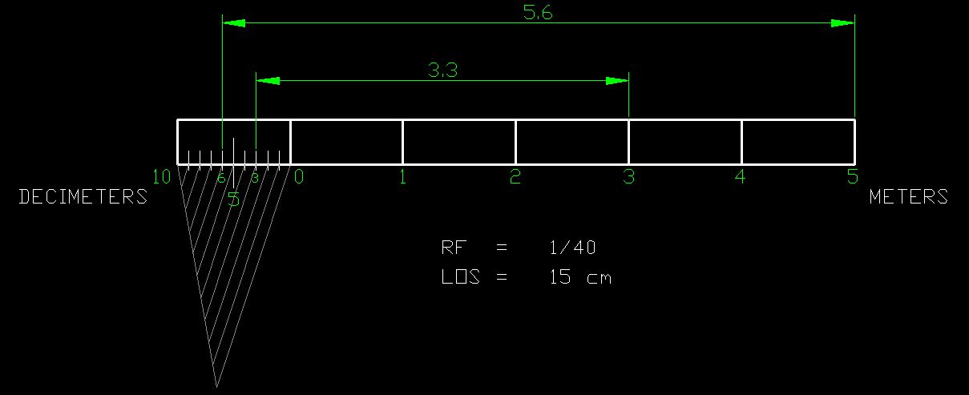
Q 1. Construct a Plain Scale to show meters & decimeters when 1 m is represented by 2.5 cm. The scale should be long enough to measure up to 6 m. Mark off 3.3 m & 5.6 m on the scale.
RF = 2.5 cm/1 m = 2.5/100 = 1/40
L.O.S = (1/40) X 6 m
    = (1/40) X 6 X 100 cm
    = 15 cm

Slide 6
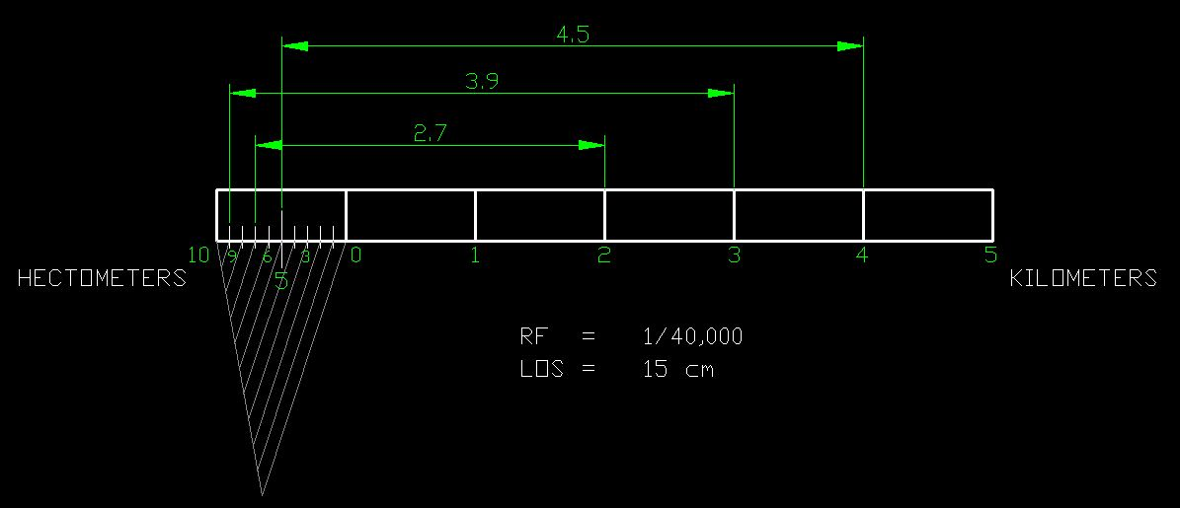
Q 2. Construct a Plain Scale to show kilometers & hectometers when 2.5 cm is equal to 1 km. The scale should be long enough to measure up to 6 km. Mark off 2.7 km, 3.9 km & 4.5 km on the scale.
RF = 2.5 cm/1 km = 2.5/100000 = 1/40000
L.O.S = (1/40000) X 6 km
    = (1/40000) X 6 X 100000 cm
    = 15 cm

Slide 7
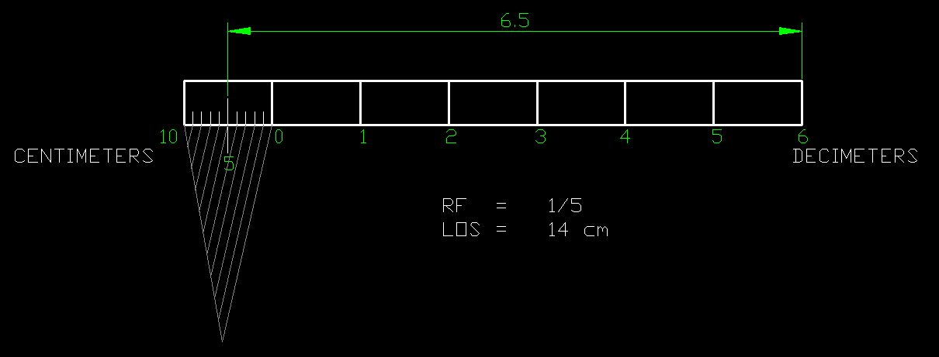
Q 3. Construct a Plain Scale to read centimeters & decimeters. The scale should be long enough to measure up to 7 decimeters. The R.F. of scale is 1/5. Mark off 6.5 decimeter on the scale.
RF = 1/5
L.O.S = (1/5) X 7 decimeter
    = (1/5) X 7 X 10 cm
    = 14 cm

Slide 8
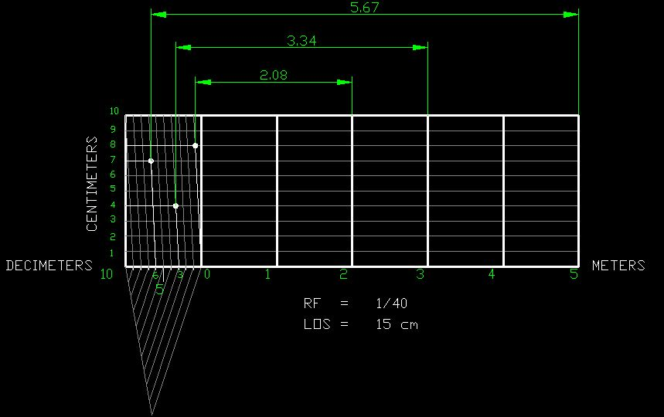
Q 4. Construct a Diagonal Scale to show meters, decimeters & centimeters when 1 m is represented by 2.5 cm. The scale should be long enough to measure up to 6 m. Mark off 2.08m, 3.34 m & 5.67 m on the scale.
RF = 2.5 cm/1 m = 2.5/100 = 1/40
L.O.S = (1/40) X 6 m = (1/40) X 6 X 100 cm = 15 cm

Slide 9
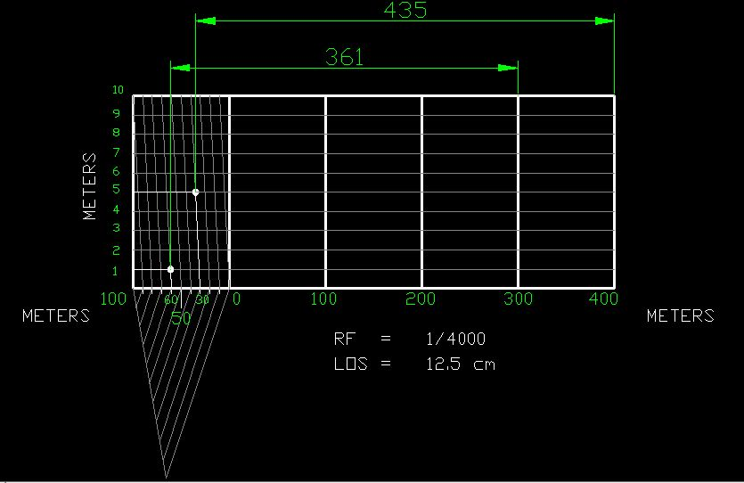
Q 5. On a certain drawing 40 m are represented by 1 cm. Draw a diagonal scale to show hundreds of meters, tens of meters & meters Consider scale length as 500 m. Mark off 361 m & 435 m on the scale.
RF = 1 cm/40 m = 1/40 x 100 = 1/4000
L.O.S = (1/4000) X 500 m = (1/4000) X 500 X 100 cm = 12.5 cm

Slide 10
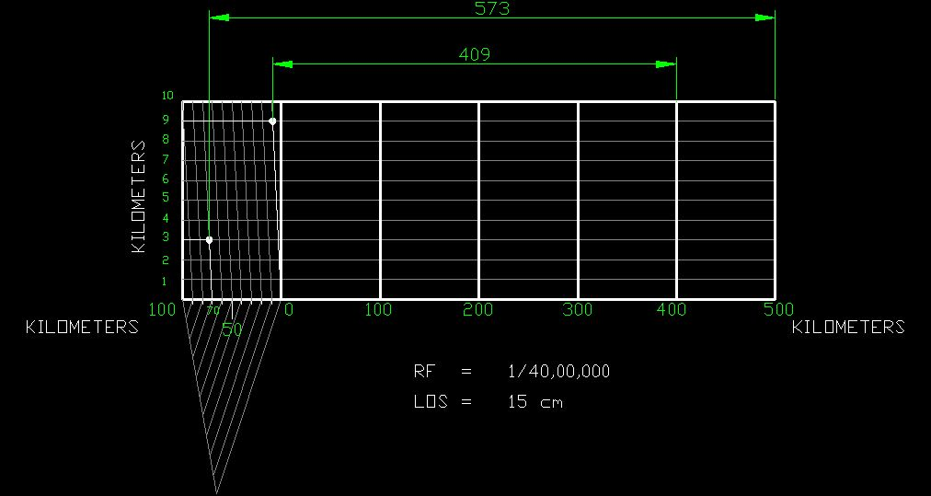
Q 6. The distance between two stations is 100 Km and it is represented on a map by a line of 2.5 cm. Draw a diagonal scale showing single Km. Mark off 409 Km & 573 Km on the scale.
RF = 2.5 cm/100 km = 2.5/(100x 100000)
= 1/4000000
2. L.O.S = (1/4000000) X 600 km
    = (1/4000000) X 600 X 100000 cm = 15 cm
Note:
Maximum length of scale is not given.
But the maximum distance to show is 573 Km.
So take maximum length of scale as 600 Km.

Slide 11
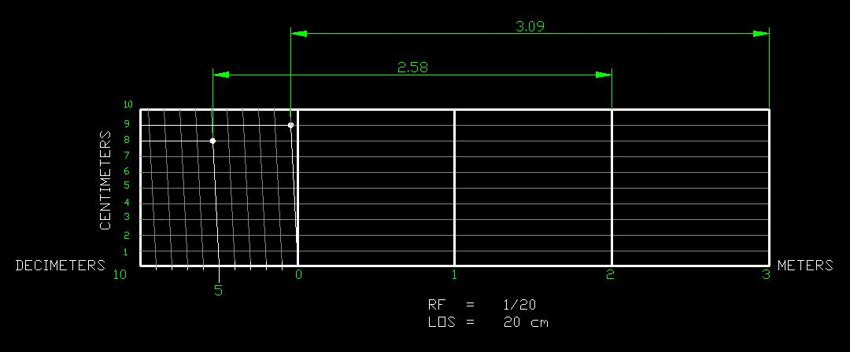
Q 7. Construct a diagonal scale to show meters, decimeters & centimeters when 1 m is represented by 5 cm. Consider maximum length of scale as 4 m. Mark off 2.58 m & 3.09 m.
RF = 5 cm/1 m = 5/100
= 1/20
2. L.O.S = (1/20) X 4 m = (1/20) x 4 x 100 cm
    = 20 cm

Slide 12
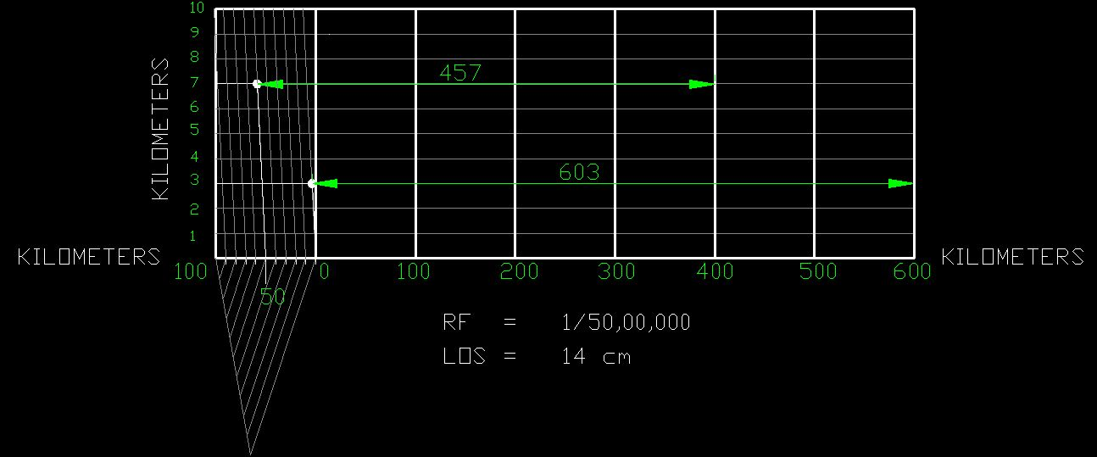
Q 8. A distance of 2000 km between two stations is represented by a line of 400 mm on a railway map. Draw a diagonal scale to show up to single Km. Mark off 457 Km & 603 Km on the scale.
RF = 400 mm/2000 km
= 400/(2000x 1000000)
= 1/50,00,000
2. L.O.S = (1/50,00,000) X 700 km
    = (1/50,00,000) X 700 X 100,000 cm
    = 14 cm
Note:
Maximum length of scale is not given.
But the maximum distance to show is 603 Km.
So take maximum length of scale as 700 Km.

Slide 13
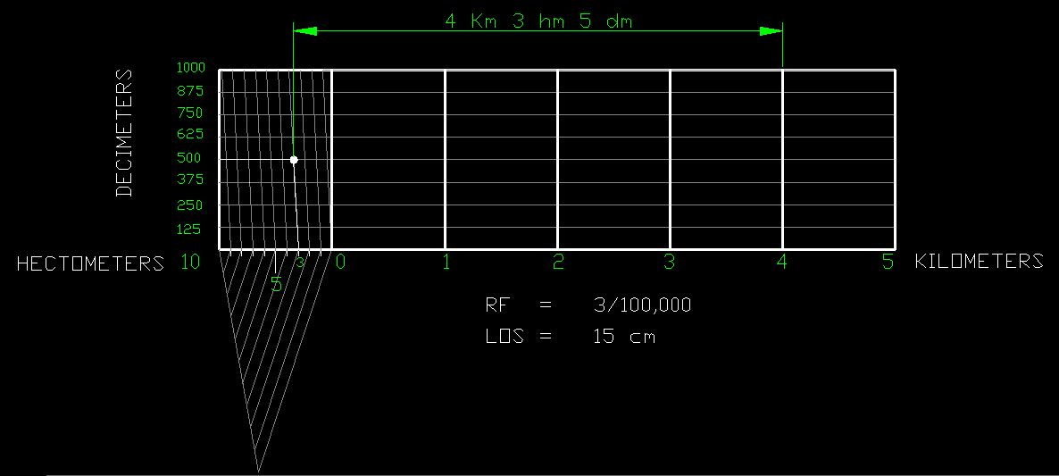
Q 9. Construct a scale to represent kilometers, hectometers & spaces of 125 decimeters when a distance of 1 km is represented by 3 cm. Consider maximum length of scale as 5 km. Mark off a distance of 4 km 3 hm 5 dm on the scale.
RF = 3 cm/1 km = 3/(1 x 100000) = 3/100,000
2. L.O.S = (3/1,00,000) X 5 km = (3/1,00,000) X 5 X 100,000 cm = 15 cm

Slide 14
PROBLEM NO.10:. Draw a diagonal scale of R.F. 1: 2.5, showing centimeters
and millimeters and long enough to measure up to 20 centimeters. Show the distance 13.4 cm on it
SOLUTION STEPS:
R.F. = 1 / 2.5
Length of scale = 1 / 2.5 X 20 cm.
= 8 cm.
1.Draw a line 8 cm long and divide it in to 4 equal parts.
(Each part will represent a length of 5 cm.)
2.Divide the first part into 5 equal divisions.
(Each will show 1 cm.)
3.At the left hand end of the line, draw a vertical line and
on it step-off 10 equal divisions of any length.
4.Complete the scale as explained in previous problems.
Show the distance 13.4 cm on it.
DIAGONAL
SCALE
13 .4 CM
10
9
8
7
6
5
4
3
2
1
0
MM
CM
5
4
3
2
1
0
5
10
15
CENTIMETRES
R.F. = 1 / 2.5
DIAGONAL SCALE SHOWING CENTIMETERS.

Slide 15
PROBLEM NO. 11 : The distance between Delhi and Agra is 200 km.
In a railway map it is represented by a line 5 cm long. Find it’s R.F.
Draw a diagonal scale to show single km. And maximum 600 km.
Indicate on it following distances. 1) 222 km 2) 336 km 3) 459 km 4) 569 km
DIAGONAL
SCALE
SOLUTION STEPS: RF = 5 cm / 200 km = 1 / 40, 00, 000
Length of scale = 1 / 40, 00, 000 X 600 X 10⁵ = 15 cm
Draw a line 15 cm long. It will represent 600 km.Divide it in six equal parts.( each will represent 100 km.)
Divide first division in ten equal parts.Each will represent 10 km.Draw a line upward from left end and
mark 10 parts on it of any distance. Name those parts 0 to 10 as shown.Join 9th sub-division of horizontal scale
with 10th division of the vertical divisions. Then draw parallel lines to this line from remaining sub divisions and
complete diagonal scale.
569 km
459 km
336 km
222 km
10
9
8
7
6
5
4
3
2
1
0
KM
KM
100
50
0
100
200
300
400
500
KM
R.F. = 1 / 40,00,000
DIAGONAL SCALE SHOWING KILOMETERS.

